Slide 1
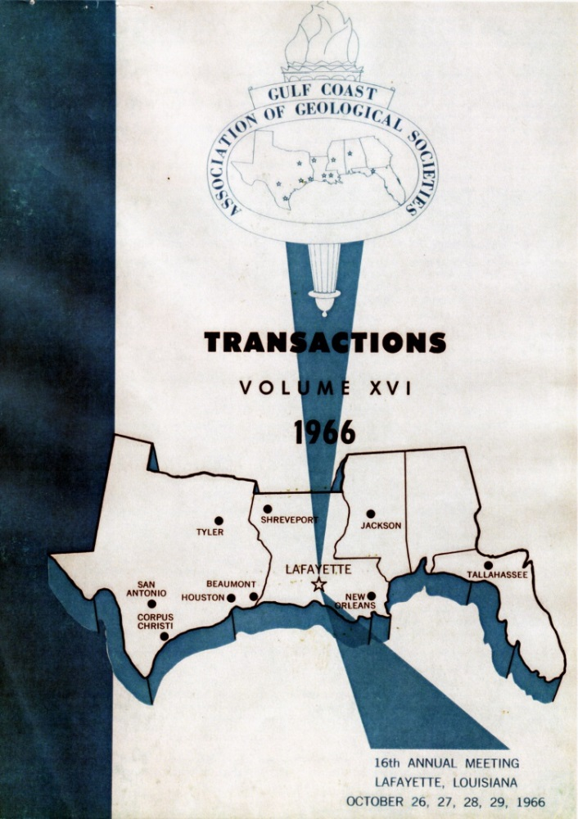
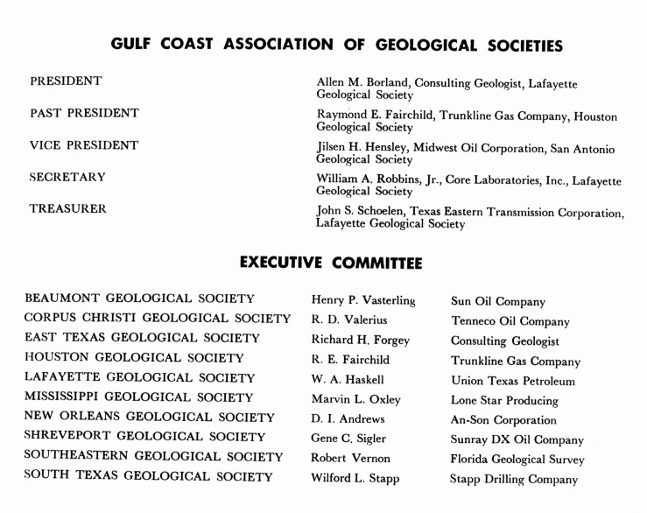
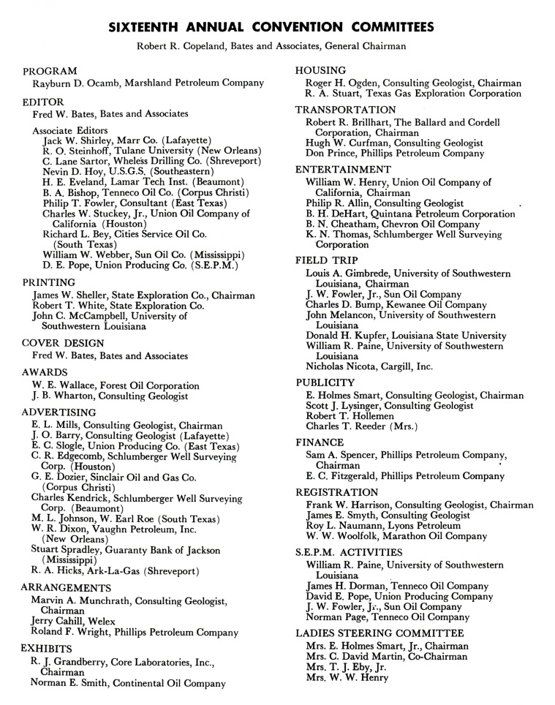
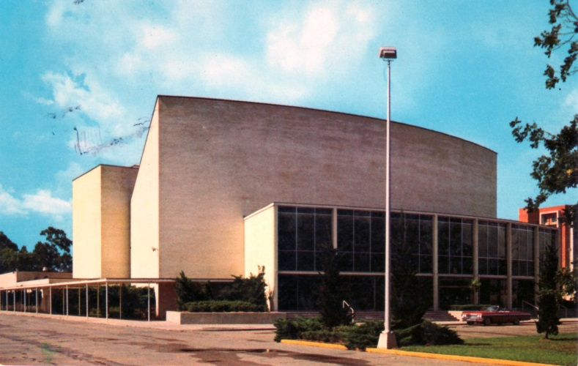
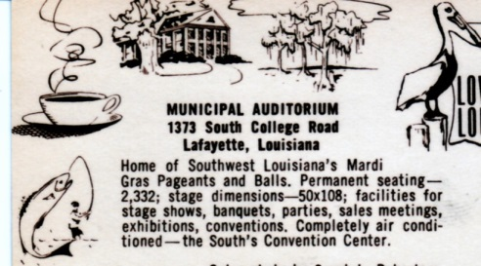
16th Annual GCAGS
Meeting
October 26-29, 1966.
Lafayette Municipal Auditorium
First time the GCAGS Annual Meeting was held in Lafayette.
Held again in Lafayette
1974
1980
1990
1999
2006
2014

Slide 2
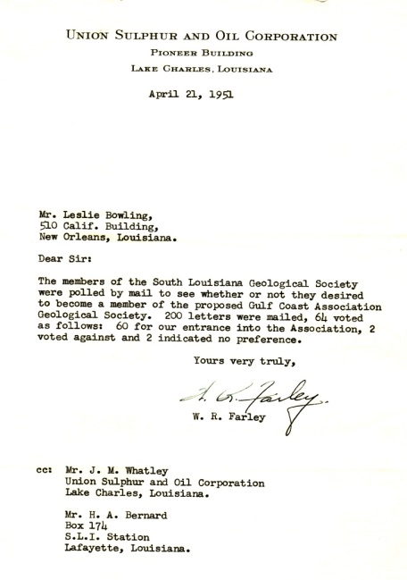
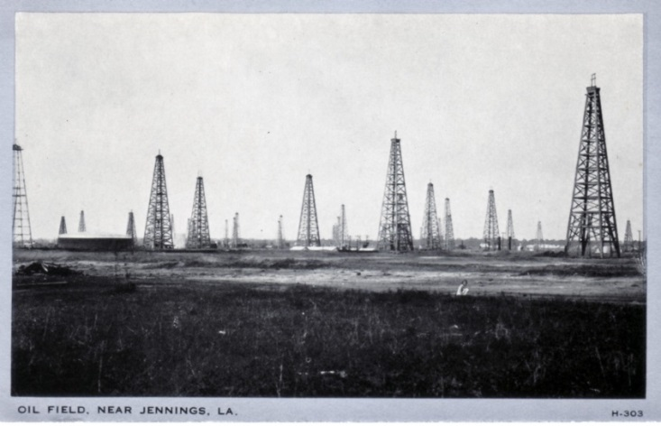
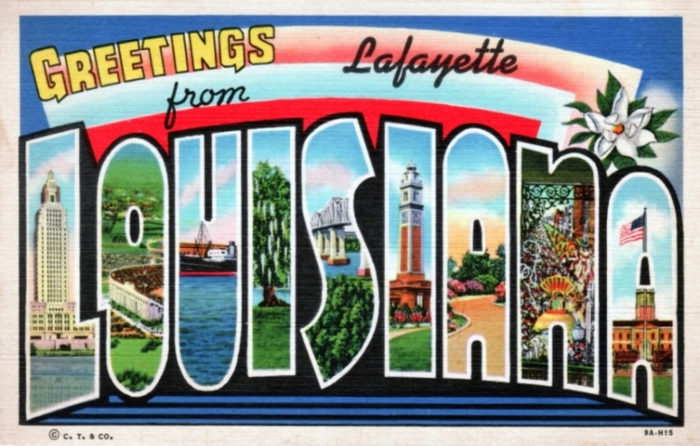
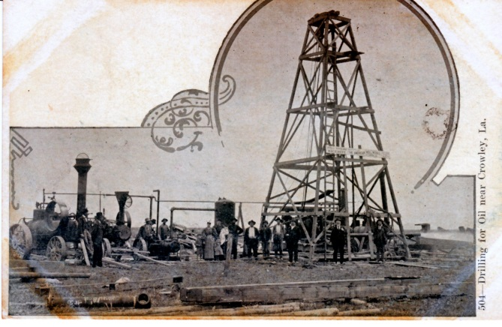
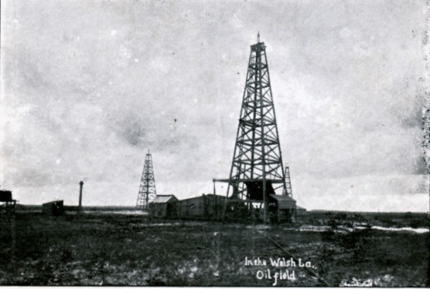
Jennings (Evangeline) oil field
Discovered 1901
47 miles west of Lafayette
South Louisiana Geological Society polls members. April,1951
“Drilling for oil near Crowley, La.”
Welsh oil field
Discovered 1903
54 miles west of Lafayette
Posters by,
Jeff Spencer, GCAGS Historian

Slide 3
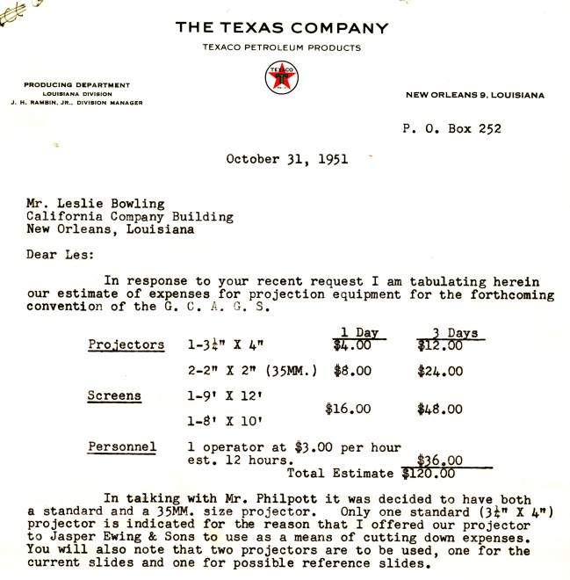
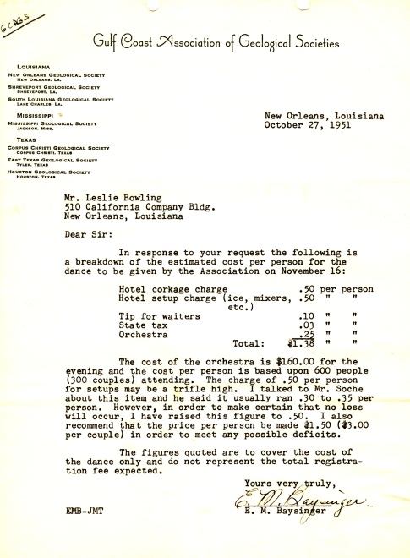
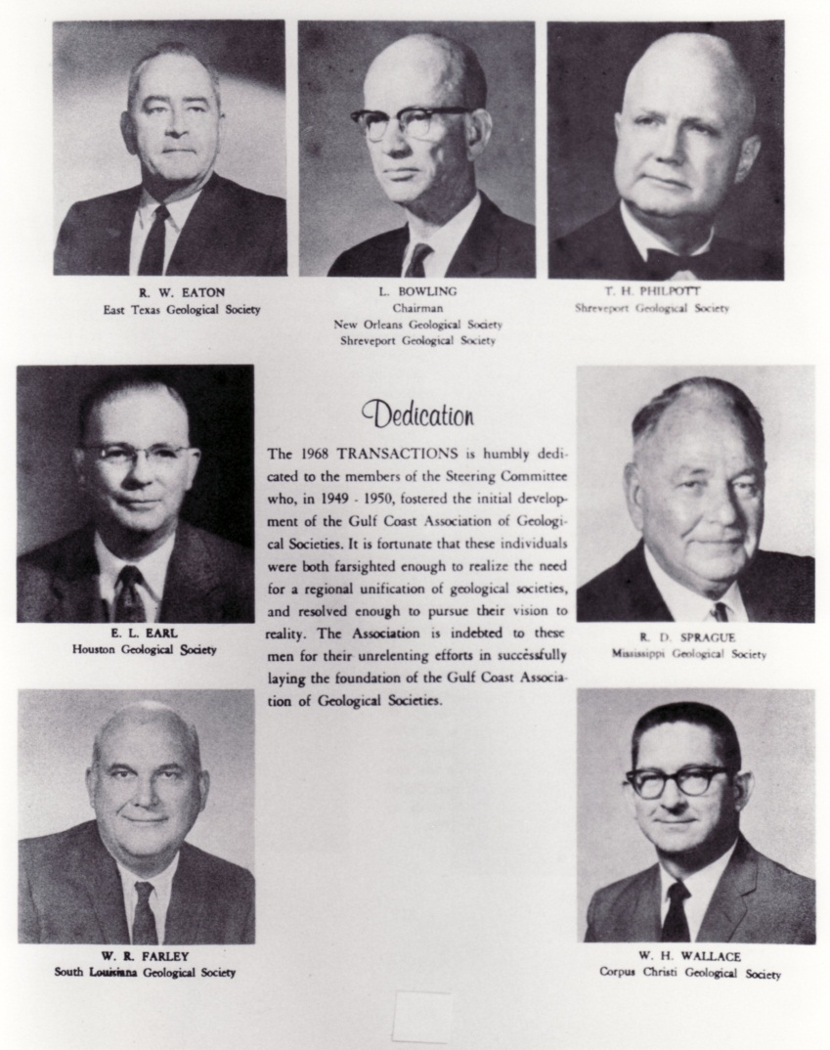
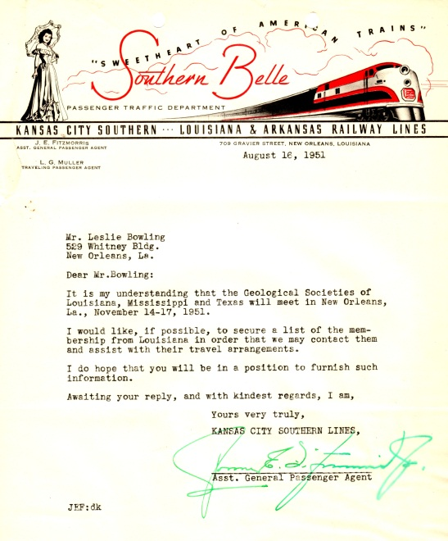
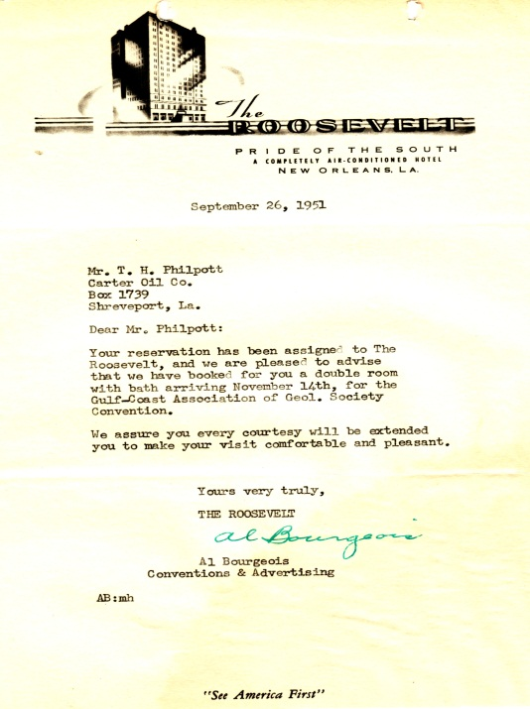
A sample of letters associated
with the formation of the GCAGS and the first annual meeting - 1951
1951 projection system costs
1951 dance, drinks & tips
1968 Transactions Dedication – organizational Steering Committee
Railroad looking for business! GCAGS-New Orleans
The Roosevelt Hotel

Slide 4
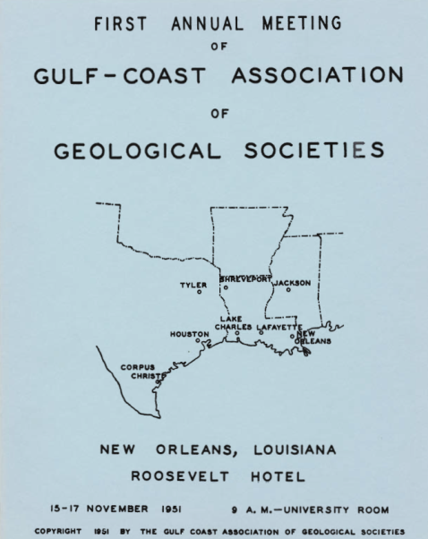
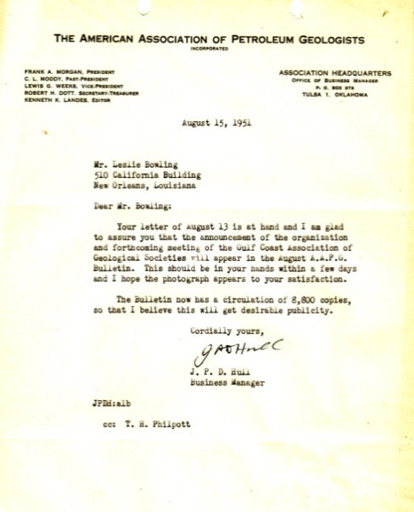
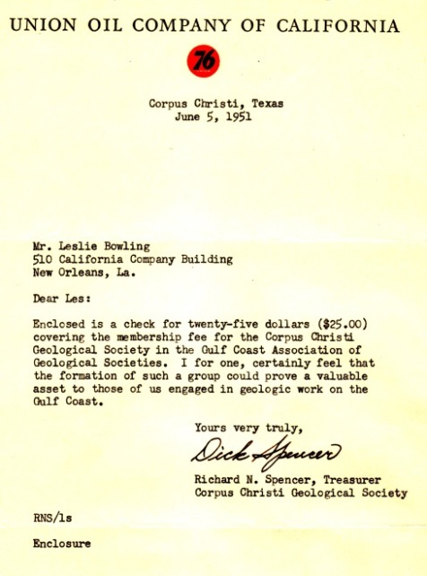
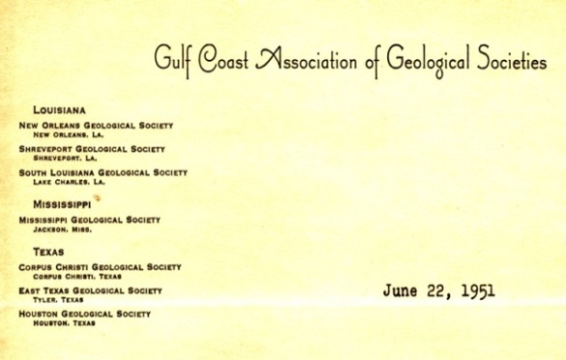
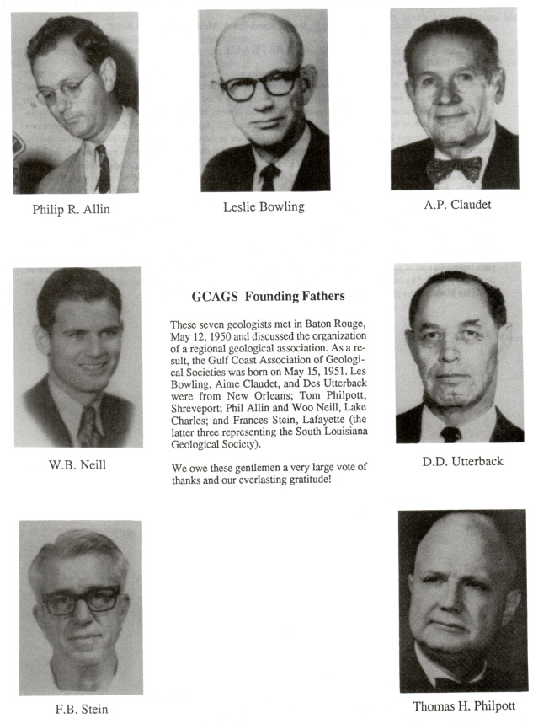
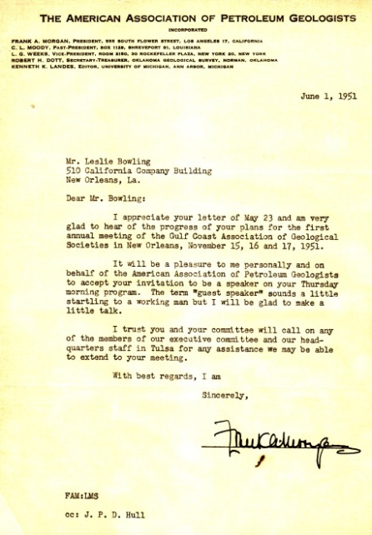
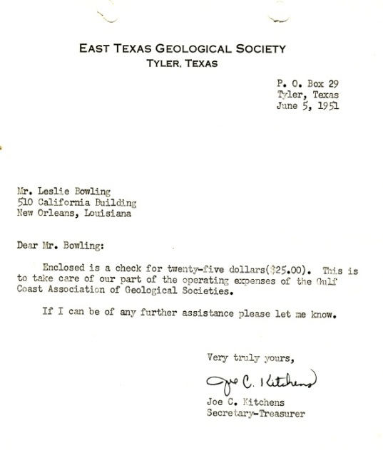
A sample of letters associated with the formation of the GCAGS and the first annual meeting - 1951
1st Transactions’ cover
AAPG Bulletin to advertise
First GCAGS letterhead
Corpus Christi Geological Society joins GCAGS - 1951
Pope, David E., 1991, The GCAGS, 1951-1990. A Salute to Forty Years of Progress, GCAGS Transactions, v. 41, p. 516-523.
AAPG President’s acceptance to attend first annual meeting of GCAGS
East Texas Geological Society joins GCAGS - 1951

